Slide 1

Transition To DevOps

Slide 2

Case Study-1 Amazon
Amazon is an American electronic commerce and cloud computing company with headquarters in Seattle.
Problem Statemen:
Back when Amazon was still running on dedicated servers, it was a constant challenge to predict how much equipment to buy to meet traffic demands and pad estimates to accommodate for unforeseen traffic spikes. As a result, about 40 percent of Amazon's server capacity was wasted.

Slide 3
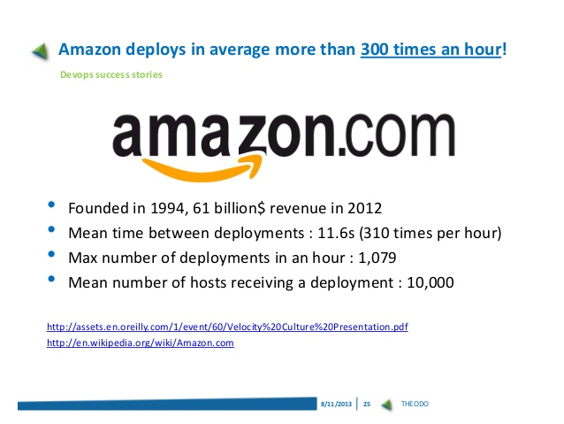
Case Study-1 Solution
Once Amazon moved to the Amazon Web Services (AWS) cloud, it allowed engineers to scale capacity up or down incrementally. Not only did this reduce spending on server capacity, but it also spurred a transition to a continuous deployment process that allows any developer to deploy their own code to whichever servers they need, whenever they want.

Slide 4

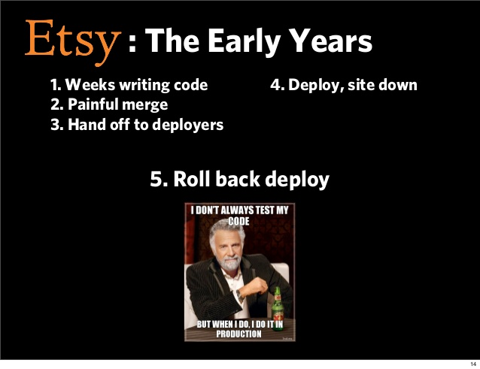
Case Study-2 Etsy
Etsy is a peer-to-peer e-commerce website focused on handmade or vintage items and supplies, as well as unique factory-manufactured items
Problem Statement:
Etsy struggled with slow, painful site updates that frequently caused the site to go down. In addition to frustrating visitors, any downtime impacted sales for Etsy's millions of users who sold goods through the online marketplace and risked driving them to a competitor.

Slide 5
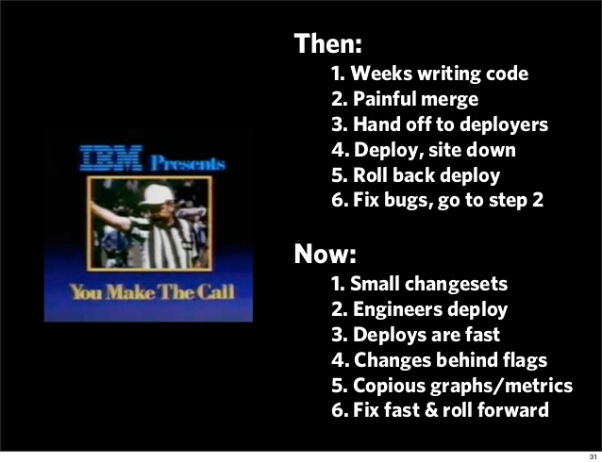
Case Study-2 Solution
Etsy transitioned from its waterfall model, which produced four-hour full-site deployments twice weekly, to a more agile approach. Today, it has a fully automated deployment pipeline, and its continuous delivery practices have reportedly resulted in more than 50 deployments a day with fewer disruptions.

Slide 6
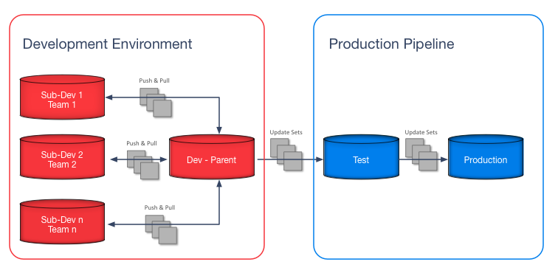
Problems before DevOps
Developers want access to the production system
This problem usually comes about after the developers have reached a tipping point in their frustration in not getting their needs/demands met in what they would consider a timely fashion.

Slide 7
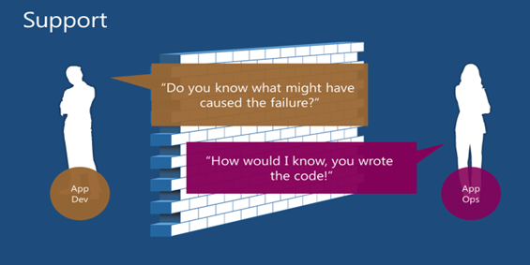
Problems before DevOps
Something is wrong...whose fault is it?
Neither the Developer team nor the operations team was ready to take the responsibility for any fault in the product.

Slide 8
Problems before DevOps
Troubleshooting can be done only by the creator of a script monster
Lets understand this with an example:
In pheonix project whole bunch of scripts have been written automating lots of parts of the process lets call this a ‘script monster’
The problem is that even though the script monster works pretty well most of the time, when it fails it’s virtually impossible for anyone other than its creator to troubleshoot.

Slide 9
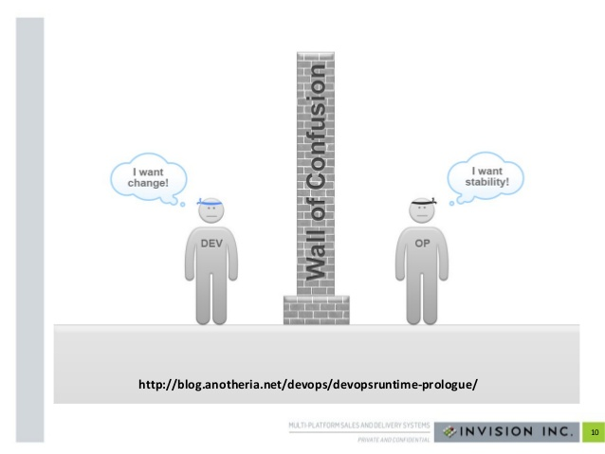
Problems before DevOps
1.I need a server now.
The most common problem is that operations teams, or those responsible for making infrastructure available to development are blockers, too slow and don’t understand the needs of the business.

Slide 10
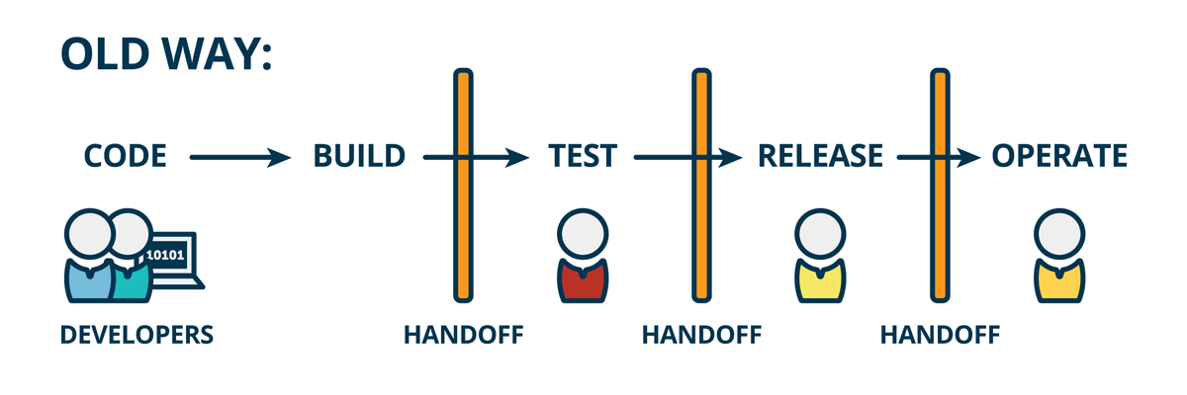
Before DevOps

Slide 11
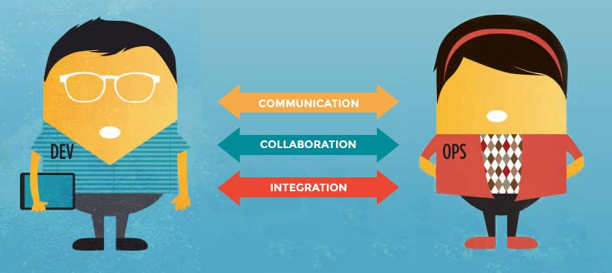
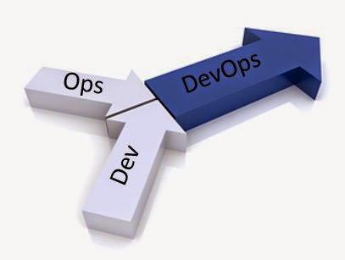
What is DevOps?
DevOps is the culmination of behaviors, community, culture and technical talent colliding to improve user experience through tools, technologies, trust and people.

Slide 12



DevOps at work
DevOps is a combination of the followings :

Slide 13
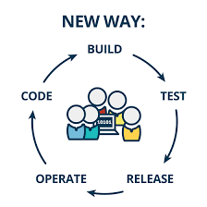
After DevOps

Slide 14
How DevOps solves the problems discussed
1.It will make it easier to deliver new infrastructure by automating it, creating or using cloud and virtualization infrastructure.
2.It will aim for an on demand deployment capability.
3.It will set some Service Level Agreements as a team.
4.It will implement tooling that will enable you to pre-empt failure or fail smartly. And that will help you identify the root cause fast.
5.It will create an environment embracing autonomy, mastery and purpose – where ideas are heard and acted upon.
6.It involves development in the definition of your change control processes and set up of any systems.

Slide 15

Transition to DevOps
1.In order to break into DevOps, you need to develop both technical skills and soft skills.

Slide 16
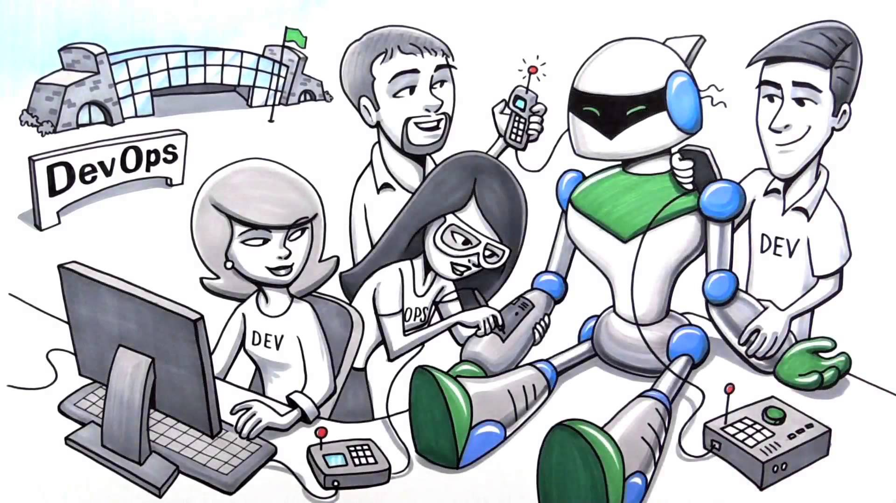
Transition to DevOps
2.Begin by aligning IT goals and redefining what ‘done’ means. Traditionally, developers define done as code complete, while operations sees it as deploying that code to production. But in a DevOps environment, the goal is to release a product the customer can use.

Slide 17
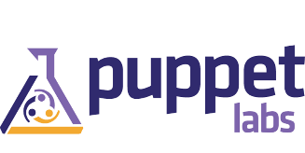




Transition to DevOps
3.The third step is to acquire a technology tooling that enables continuous integration and deployment.
Code Tool
System Monitoring Tool
Open Source Proxy Server
Version Control System
Automated Build Tool

Slide 18

Transition to DevOps
4.You embed site operators or ‘site reliability engineers’, as DevOps organizations call them within application teams and cultivate a deep respect between the two groups, eliminating any borders between them.

Slide 19
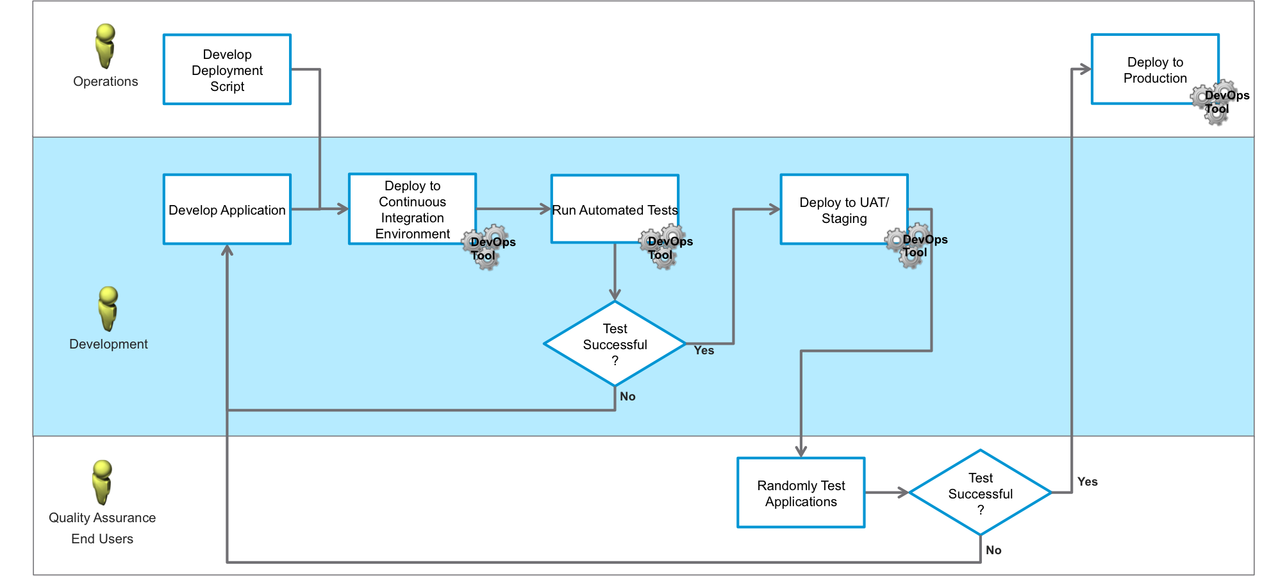
Transition to DevOps
5.A good place to begin is to take a small project, and apply a new method to the development, test, deploy and remediate process to retrain the team’s muscles.
Below is one example:

Slide 20
Pre-requisites for learning DevOps
Anyone with basic experience or knowledge in any of the following stream (but not limited to) can become a DevOps Practitioner:
1. Programming (any language)
2. Shell scripting
3. System admin
4. IT Services - Ops and Support,
5. Build and release
6. QA or Testing

Slide 21
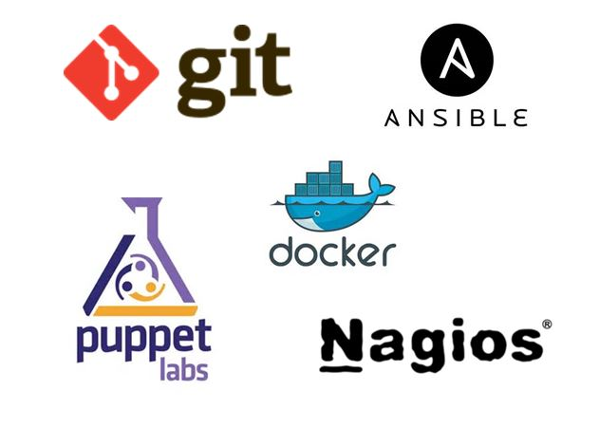
DevOps Tools.

